Slide 1
Functional Programming in Java
Dana Nica

Slide 2
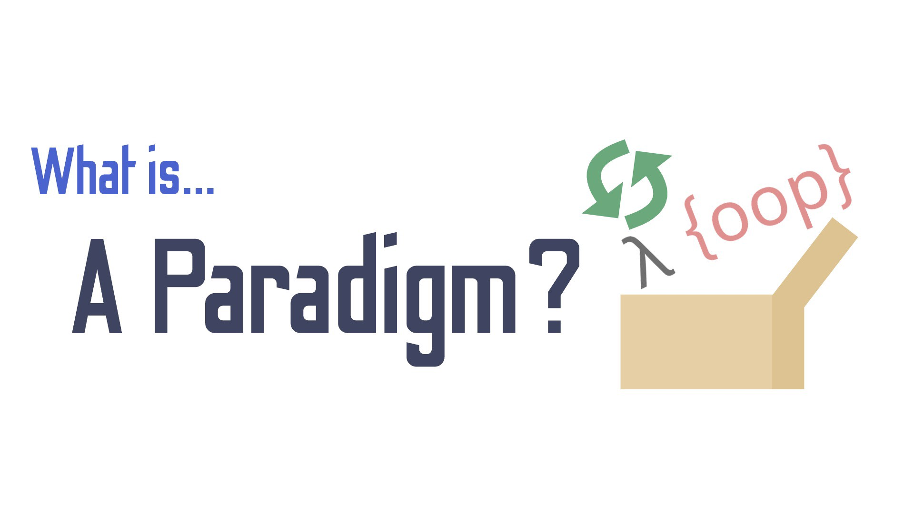
Notes:
Când se discută despre limbaje de programare, automat apare și cuvântul ”paradigmă”.
Paradigma este o idee, un set de reguli care precizează modul în care se construiește un program într-un anume limbaj de programare. Paradigma de programare are o mare influență asupra modului în care se gândește rezolvarea unei probleme. Paradigma spune cum se reprezinta datele și cum se prelucrează.
Aveți grijă că paradigma de programare nu are nicio legătură cu sintaxa. Două limbaje cu sintaxă diferită pot implementa programe sub aceeași paradigmă.

Slide 3
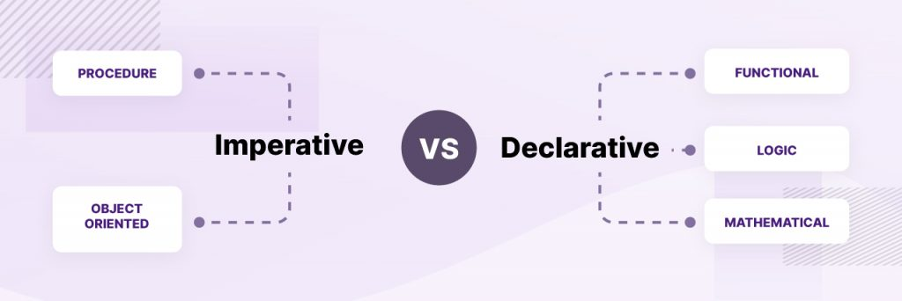
Imperative vs Declarative
Notes:
În cadrul paradigmei imperative calcul se face sub formă de instrucțiuni care modifică starea unui program.
La fiecare moment de timp programul are o altă stare în funcție de instrucțiunile care sunt executate. Așa cum în limbajul natural exprimarea imperativă trimite la acțiune, așa și instrucțiunile dau comenzi calculatorului.
Din clasa limbajelor imperative fac parte și limbajele procedurale, de care sunt sigur că ați auzit: C. Acestea lucrează pe bază de proceduri, drept abstractizare pentru instrucțiuni.
Diferența cheie între programarea declarativă și imperativă este că programarea declarativă se concentrează pe ceea ce ar trebui să realizeze programul, în timp ce programarea imperativă se concentrează pe modul în care programul ar trebui să obțină rezultatul.
Oferă simplitate. Programarea declarativă exprimă rezultatul necesar. Acesta explică logica unui calcul fără a descrie fluxul de control.

Slide 4
Functional Programming
Paradigma de programare in care :
Nu există atribuiri, nu există secvență de comenzi, o anumită expresie are o singură valoare pe tot parcursul programului.
Elementul central funcția (văzută însă nu în sens procedural, ci mai degrabă în sens matematic).
Notes:
Una dintre principalele diferențe aduse de programarea funcțională este absența efectelor laterale, și se datorează faptului că programarea funcțională este atemporală. Nu există atribuiri, nu există secvență de comenzi, o anumită expresie are o singură valoare pe tot parcursul programului. Elementul central este funcția (văzută însă nu în sens procedural, ci mai degrabă în sens matematic). Programele constau în compuneri și aplicări de funcții
calculul se bazează pe evaluarea unor funcții matematice a căror stare nu se schimbă. Mai pe scurt, este programare bazată pe matematică și pe teoria funcțiilor.

Slide 5
Ce sunt efectele laterale?

Slide 6
Prime number

Slide 7
Declarative
Notes:
//TODO: rewrite this (use I instead of t)

Slide 8
Insertion Sort
Algorithm
To sort an array of size n in ascending order:
1: Iterate from arr[1] to arr[n] over the array. 2: Compare the current element (key) to its predecessor. 3: If the key element is smaller than its predecessor, compare it to the elements before. Move the greater elements one position up to make space for the swapped element.

Slide 9
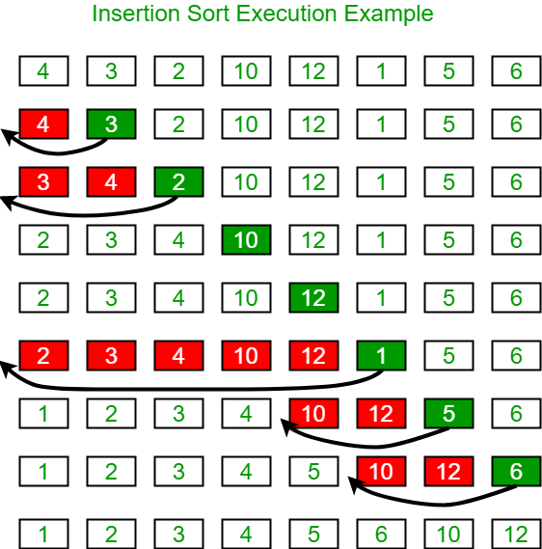

Slide 10
Imperative

Slide 11
Declarative
Notes:
In computer science, an abstract data type (ADT) is a mathematical model for data types. An abstract data type is defined by its behavior (semantics) from the point of view of a user, of the data, specifically in terms of possible values, possible operations on data of this type, and the behavior of these operations. This mathematical model contrasts with data structures, which are concrete representations of data, and are the point of view of an implementer, not a user.
Formally, an ADT may be defined as a "class of objects whose logical behavior is defined by a set of values and a set of operations”
Observați asemănarea izbitoare între codul Haskell și definirea axiomelor unui TDA, studiată la cursul de Analiza Algoritmilor funcțiile sunt definite pe cazurile de aplicare și folosesc recursivitatea pentru a referi un caz deja implementat.
Funcția insertion_sort primește o listă ca parametru, și o sortează prin inserție. Dacă parametrul lui insertion_sort este lista vidă, atunci funcția va întoarce lista vidă (care este sortată trivial). Altfel, insertion_sort sortează recursiv sublista xs, apoi inserează pe poziția corespunzătoare în această listă (sortată) elementul x.
Funcția insert primește doi parametri:
un element
o listă sortată.
Dacă lista primită ca parametru este vidă, insert întoarce o listă cu un singur element (primul parametru). Altfel, introduce elementul y în listă, astfel încât sortarea să se conserve.
Exemplul de mai sus este sugestiv pentru modul de construcție a programelor funcționale: rezultatul final se obține din rezultate intermediare, prin compuneri și aplicări de funcții. Definind funcția insertion_sort pe o listă nevidă, am observat că avem nevoie întâi să sortăm recursiv lista fără primul element, apoi să inserăm primul element “la locul lui” în lista sortată. Programarea funcțională nu ne permite secvențe de instrucțiuni de tipul “întâi fă asta, apoi fă cealaltă”, așa că am reformulat secvența de comenzi într-o secvență de aplicări de funcții: “inserează primul element în rezultatul obținut prin sortarea restului”. Nu este nicio problemă că încă nu avem o funcție care inserează un element într-o listă sortată; de fiecare dată când avem nevoie de un rezultat încă necalculat, ne putem imagina (wishful thinking) că avem deja o funcție care realizează calculul respectiv și putem apela acea funcție, urmând să o implementăm ulterior. Exact așa am procedat cu funcția insert. Această abordare ne face să spunem că programarea funcțională este de tip wishful thinking.
Observați în exemplul de mai sus și absența efectelor laterale. Niciuna dintre funcții nu modifică zone de memorie din afara acesteia.

Slide 12
Key concepts
Pure functions
Function Composition
First-class and higher-order
Referencial transparency
Imutability
Lazy evaluation
Recursion

Slide 13
Pure Functions
A pure function has 2 properties
Same input will always generate same output
No side effects
Notes:
These two properties guarantee that pure functions can safely be used in any environment, even in a parallel/concurrent fashion. Recall that a pure function depends only on its arguments and no external state. There are no side effects.

Slide 14
Notes:
Functions are supposed to be a first-class-citizen like any other value, so they need to be able to be assigned to variables, used as arguments by other functions, and be able to be returned by functions.
A higher-order function is defined by accepting one or more functions as arguments, or returning a function as its result, or both. This is necessary for the next pillar.

Slide 15
Function composition
Notes:
The combination of pure functions to create a more complex expression. This way, the initial functions can be small, on-topic, and reusable, but the composed function will perform a more complete task in a data structure.

Slide 16
Notes:
An expression is called referentially transparent if it can be replaced with its corresponding value without changing the program's behavior. This requires that the expression be pure, that is to say the expression value must be the same for the same inputs and its evaluation must have no side effects. An expression that is not referentially transparent is called referentially opaque.
Due to the predictable result for non-changing input arguments, we could replace a once-run function with its return value. This is called referential transparency.
It’s a result of pure expressions and can be used as an optimization technique called memoization, or “function call caching”, to save unnecessary re-calculations of already evaluated expressions.

Slide 17

Imutability
Notes:
Mutating data-structures can create unexpected side-effects, and we must check against them. With immutability, we can keep our data structures predictable and side-effect free, and easier to reason with.
Data-structures shouldn’t be modifiable after being initialized. To change/mutate a data-structure, we must create a new variable containing the changed value.
Just like pure functions, we can safely use any data-structure without side-effects, even in parallel/concurrent environments, without uncertain results or issues due to unsynchronized access, or changes to out-of-scope state

Slide 18
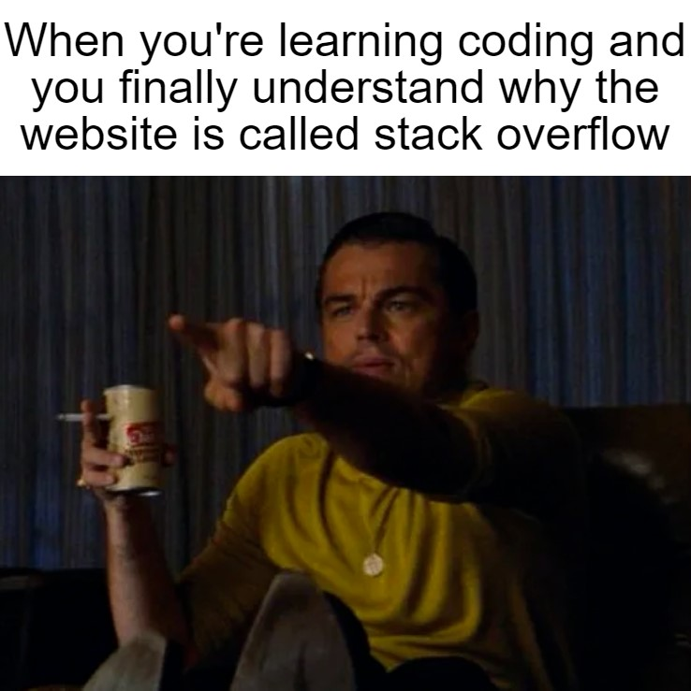
Recursion
A self-calling function that acts like a loop, executing the same expression multiple times until an end condition is reached and returns a “non-self-function call”.
This is important, or we easily end up with infinite recursions, until we get a java.lang.StackOverflowError.

Slide 20
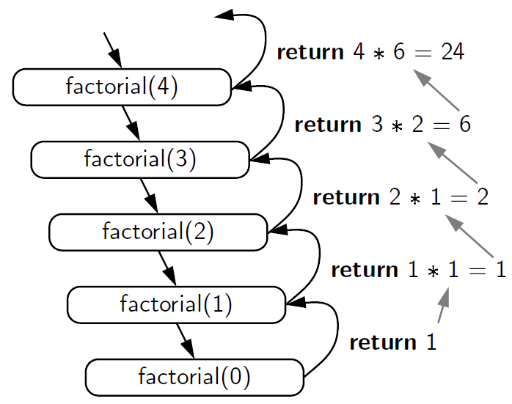

Slide 21
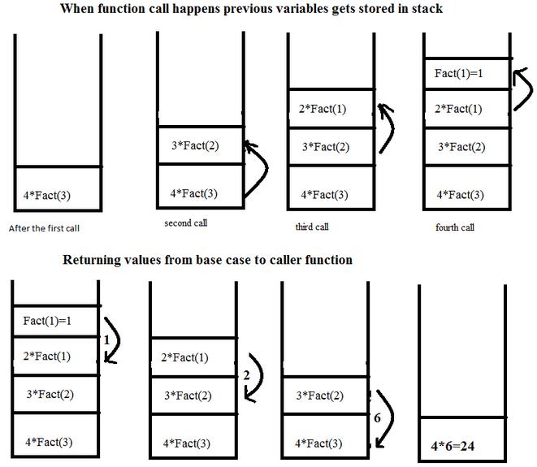

Slide 22
Tail Recursion

Slide 23


Functional Programming With Java: What’s in the Box

Slide 24
java.util.function package
Interface | Function Descriptor | Description
Consumer<T> | T -> void | Represents an operation that accepts a single input argument and returns no result.
Function<T, R> | T -> R | Represents a function that accepts one argument and produces a result.
Predicate<T> | T -> boolean | Represents a predicate (boolean-valued function) of one argument.
Supplier<T> | () -> T | Represents a supplier of results.
UnaryOperator<T> | T -> T | Represents an operation on a single operand that produces a result of the same type as its operand.

Slide 25
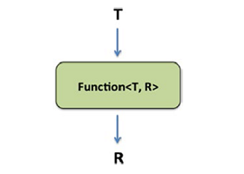
Function interface
Function<T, R> is a built-in functional interface included in Java SE 8 in the java.util.function package. The main purpose of this interface is mapping scenarios - when an object of one type is taken as input and it is converted (or mapped) to another type. The most common case for using the Function interface is in streams where the map function of a stream accepts an instance of Function to convert the stream of one type to a stream of another type.

Slide 27
Lambda expression
Lambda expressions are introduced in Java 8 to facilitate functional programming and simplify the development.
Lambda expression can be called an anonymous function or a method without declaration, which can be created without belonging to any class.

Slide 28
Method Reference = compact lambda expressions for methods that already have a name
Type | Example
Reference to a static method | ContainingClass::staticMethodName
Reference to an instance method of a particular object | containingObject::instanceMethodName
Reference to an instance method of an arbitrary object of a particular type | ContainingType::methodName
Reference to a constructor | ClassName::new

Slide 29
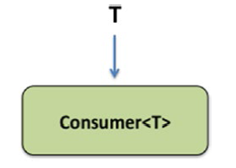
Consumer Interface
Consumer<T> is a built-in functional interface included in Java SE 8 in the java.util.function package. The consumer is used when an object should be taken as input and some operation should be performed on the object without returning any result.

Slide 31
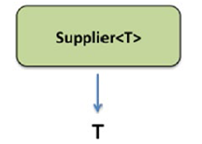
Supplier Interface
Supplier<T> is a built-in functional interface included in Java SE 8 in the java.util.function package. The Supplier can be used in cases when there is no input but output is expected.

Slide 33
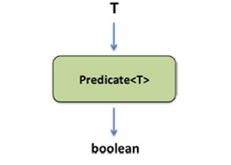
Predicate
The Predicate is a built-in functional interface included in Java SE 8 in the java.util.function package, which can be used in cases when an object should be evaluated for a given test condition, and a boolean result of the test should be returned.

Slide 34
UnaryOperator Interface
The UnaryOperator is a built-in functional interface included in Java SE 8 in the java.util.function package, that extends java.util.function.Function. It is used to work on a single operand and it returns the same type as an operand. The UnaryOperator is used as a lambda expression to pass as an argument.

Slide 35
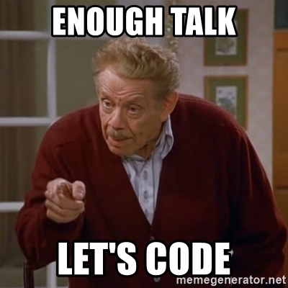

Slide 36
Optional
Make your code more readable and protect it against null pointer exceptions.
A wise man once said you are not a real Java programmer until you've dealt with a null pointer exception
Joking aside, the null reference is the source of many problems because it is often used to denote the absence of a value.
Java SE 8 introduces a new class called java.util.Optional that can alleviate some of these problems.

Slide 37
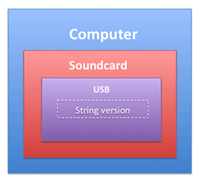
Use case
String version = computer.getSoundcard().getUSB().getVersion();
What's possibly problematic with the following code?

Slide 38
Solution

Slide 39
Consequences
Unfortunately, we need a lot of boilerplate code to make sure we don't get a NullPointerException.
In addition, it's just annoying that these checks get in the way of the business logic. In fact, they are decreasing the overall readability of our program.

Slide 40
Optional in a Nutshell
Java SE 8 introduces a new class called java.util.Optional<T> that is inspired from the ideas of Haskell and Scala. It is a class that encapsulates an optional value.
You can view Optional as a single-value container that either contains a value or doesn't (it is then said to be "empty
The purpose of Optional is not to replace every single null reference in your codebase but rather to help design better APIs in which—just by reading the signature of a method—users can tell whether to expect an optional value.
In addition, Optional forces you to actively unwrap an Optional to deal with the absence of a value; as a result, you protect your code against unintended null pointer exceptions.

Slide 41
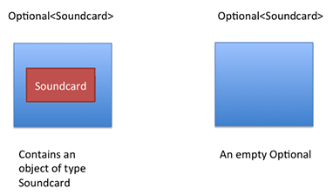
Example

Slide 42
Impact on code

Slide 43
Patterns for Adopting Optional

Slide 44
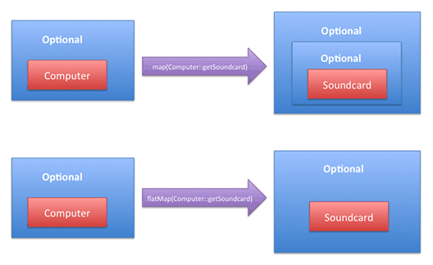
Flatmap vs Map

Slide 46
Stream
Introduced in Java 8, the Stream API is a new layer used to process collections of objects.
Using stream you can process data in a declarative way.
A stream is a sequence of objects that supports various methods which can be pipelined to produce the desired result.
The features of Java stream are:
A stream is not a data structure instead it takes input from the Collections, Arrays or I/O channels.
Streams don’t change the original data structure, they only provide the result as per the pipelined methods.
Each intermediate operation is lazily executed and returns a stream as a result, hence various intermediate operations can be pipelined. Terminal operations mark the end of the stream and return the result.

Slide 47
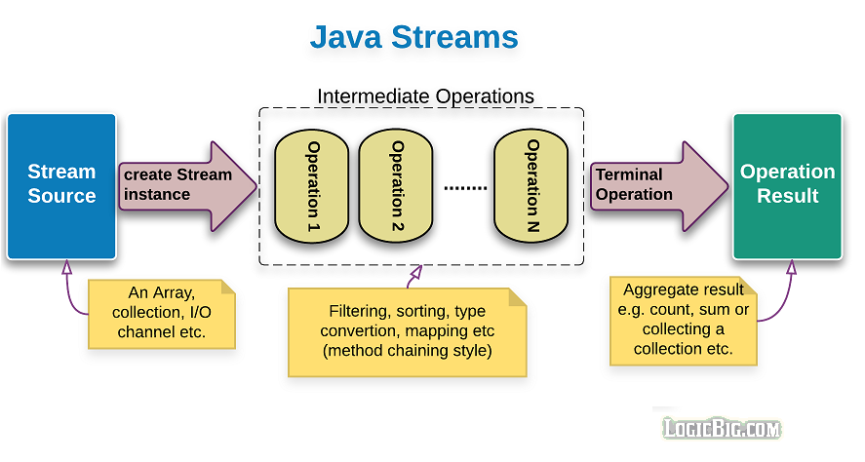
Notes:
Stream operations can either be executed sequentially or parallel. when performed parallelly, it is called a parallel stream.

Slide 48
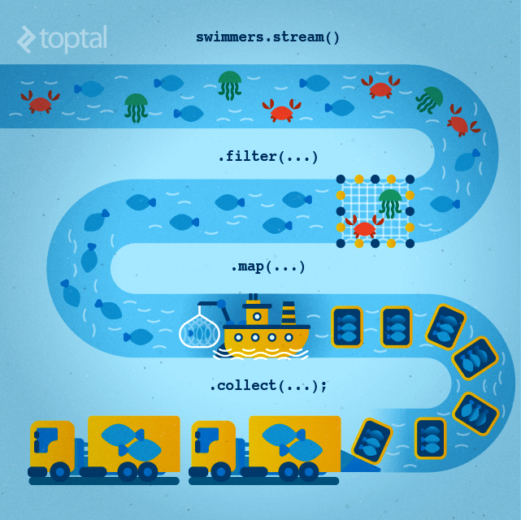

Slide 49
Code example

Slide 50


Slide 51
Java Stream vs Collection
All of us have watched online videos on Youtube. When we start watching a video, a small portion of the file is first loaded into the browser and starts playing. we don’t need to download the complete video before we start playing it. This is called streaming.
At a very high level, we can think of that small portions of the video file as a stream, and the whole video as a Collection.
At the granular level, the difference between a Collection and a Stream is to do with when the things are computed.
A Collection is an in-memory data structure, which holds all the values that the data structure currently has. Every element in the Collection has to be computed before it can be added to the Collection.
While a Stream is a conceptually a pipeline, in which elements are computed on demand.
Notes:
This concept gives rise to significant programming benefits. The idea is that a user will extract only the values they require from a Stream, and these elements are only produced—invisibly to the user—as and when required. This is a form of a producer-consumer relationship.

Slide 52
Conclusion
Based on the above points, if we list down the various characteristics of Stream, they will be as follows:
Not a data structure
Designed for lambdas
Do not support indexed access
Can easily be aggregated as arrays or lists
Lazy access supported
Parallelizable

Slide 53
Resources
https://www.examclouds.com/java/ocpjp8-update-from-java6/lambda
https://www.tutorialspoint.com/java8/java8_streams.htm
https://www.oracle.com/technical-resources/articles/java/java8-optional.html
https://www.baeldung.com/java-optional
https://howtodoinjava.com/java8/java-streams-by-examples/
PS: https://carbon.now.sh/ (cool website to Create and share beautiful images of your source code)

